Slide 1
Multi-Class Protein Fold Recognition Using Support Vector Machines and Neural Networks
Bioinformatics Vol. 17 no. 4 2001 Pages 349–358
Chris H.Q. Ding ,Inna Dubchak
Presenter: Jun-Shong Lin
Date: Jan. 4, 2007

Slide 2
Abstract
Motivation: Protein fold recognition is an important approach to structure discovery without relying on sequence similarity. We study this approach with new multi-class classification methods and examined many issues important for a practical recognition system.
Results: Most current discriminative methods for protein fold prediction use the one-against-others method, which has the well-known ‘False Positives’ problem. We investigated two new methods: the unique one-against-others and the all-against-all methods. Both improve prediction accuracy by 14–110% on a dataset containing 27 SCOP folds. We used the Support Vector Machine (SVM) and the Neural Network (NN) learning methods as base classifiers. SVMs converges fast and leads to high accuracy.

Slide 3
Abstract (Cont.)
When scores of multiple parameter datasets are combined, majority voting reduces noise and increases recognition accuracy. We examined many issues involved with large number of classes, including dependencies of prediction accuracy on the number of folds and on the number of representatives in a fold. Overall, recognition systems achieve 56% fold prediction accuracy on a protein test dataset, where most of the proteins have below 25% sequence identity with the proteins used in training.

Slide 4
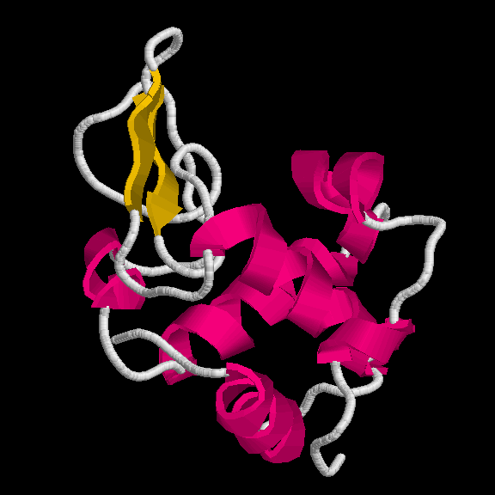
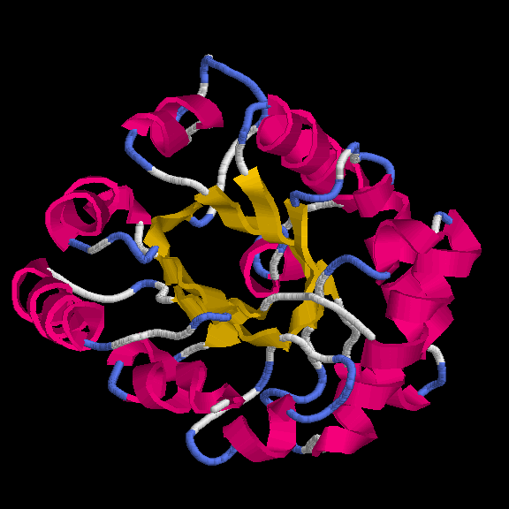
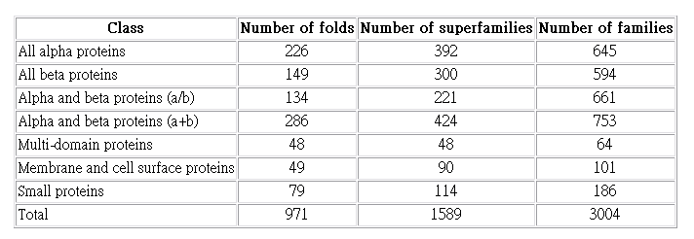

Introduction
SCOP (Structural Classification of Proteins ) 1.71 release
27599 PDB Entries (18 Jan 2005). 75930 Domains.
Class
27 Folds
Common Fold
Superfamily
α+β:
α/β:
Family
Domain
βαβ

Slide 5
Introduction
The approach in determining structure similarity without sequence similarity, using machine learning methods such as Neural Networks (NNs) and Support Vector Machines (SVMs).
An advantage of SVM is its fast convergence in training, about 10–100 faster than in NN.

Slide 6
Multi-Class Prediction Methods
1
2
3
4
5
?
One-versus-others method:
Unique one-versus-others method:
vote
?
5
5 two-way classifiers
Ambiguity!
4
3
1
2
vote
vote
?
2
2
3
?
vote
5
3
4
3
4
3
4
vote
1
2
2
4
5 two-way classifiers
3 two-way classifiers

Slide 7
Multi-Class Prediction Methods
All-versus-all method:
However, for the 600 folds in SCOP database, this task can be easily handled using current computers. The SVMs can be trained in reasonable time (1–2 days on a workstation), and the estimated memory requirement is about 1 GB.
1
2
3
4
5
?
vote
2
3
10 two-way classifiers

Slide 8
Dataset
Training Dataset:
PDB select sets where two proteins have no more than 35% of the sequence identity. We utilized 27 most populated folds in the database which have seven or more proteins and represent all major structural classes:
α, β, α / β, and α + β.

Slide 9
Dataset
Independent Test Dataset:
As an independent dataset for testing we used the PDB-40D set developed by the authors of the SCOP database. This set contains the SCOP sequences having less than 40% identity with each other.
All PDB-40D proteins that had higher than 35% identity with the proteins of the training set were excluded from the testing set.

Slide 10
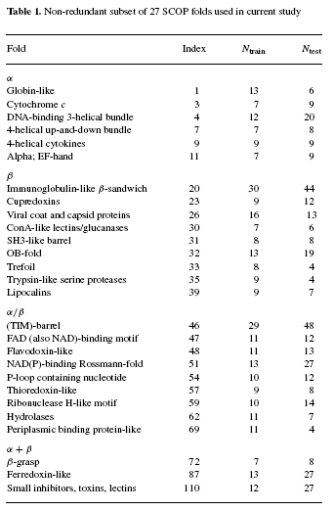
27 Most Populated Folds

Slide 11
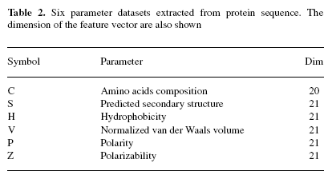
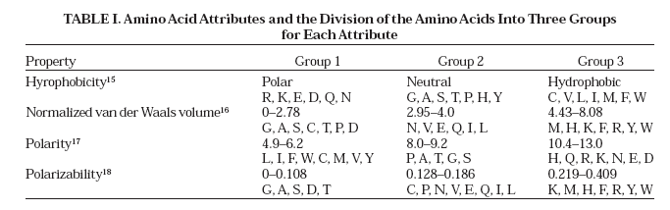
Feature Vector Extraction
Predicted Secondary Structure (S):
Helix (H) Strand (E) and Coil (C).

Slide 12

Feature Vector Extraction
Feature vectors are extracted from the primary sequence based
on three descriptors:
Composition: 38.5(10/26), 61.5(16/26)
Transition (A-B、B-A) : 40.0(10/25)
Distribution(0%、25%、50%、75%、100%):
3.8(1/26), 38.5(10/26), 46.1(12/26), 73.1(19/26), 100.0(26/26),
7.6(2/26), 23.1(6/26), 53.8(14/26), 76.9(20/26), 92.3(24/26).

Slide 13
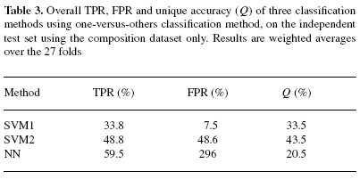

Accuracy Measure
We can similarly define
TPR_{i} = TP_{i}/n_{i} , and FPR_{i} = FP_{i}/n_{i} ,
for each class i , and overall TPR
(True Positive Rates) and FPR
(False Positive Rates) as the
weighted average.
Class 1:
n₁=10
c₁= 5
Q₁= 50%
TPR₁= 70%
FPR₁= 40%

Slide 14


Tests on Independent Datasets
One-versus-others method:
We build 27 two-way one-versus-others classifiers, with either SVM or NN.
All 6 parameter datasets are combined

Slide 15
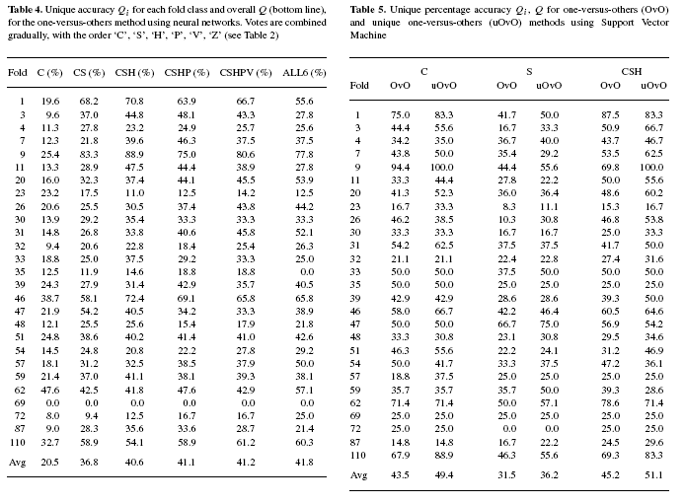
Tests on Independent Datasets

Slide 16

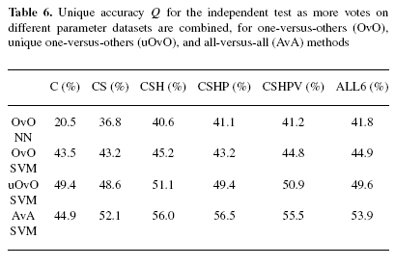
Tests on Independent Datasets
Unique one-versus-others method:
six 2-way classifiers

Slide 17
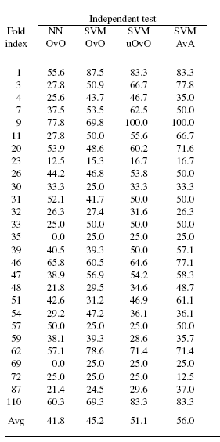

Tests on Independent Datasets
All-versus-all method:
For the 27 fold classes, the prediction system consists of 27 × ( 27 − 1)/ 2 = 351 two-way SVM classifiers, each between one pair of folds.

